Slide 1


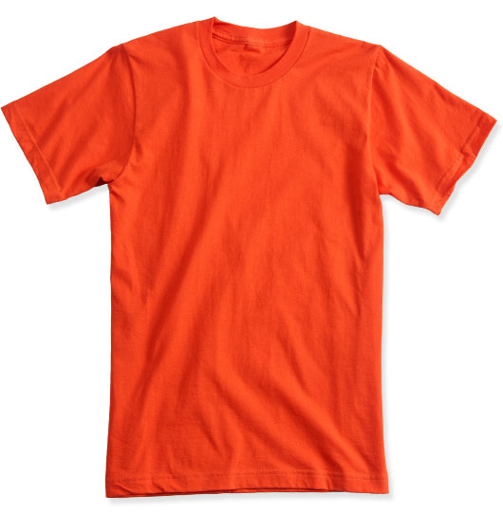
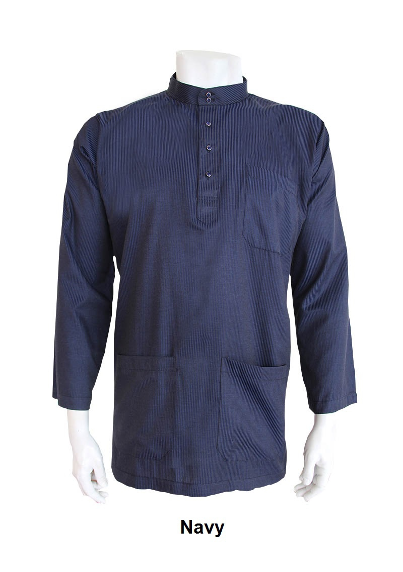
Supplier’s dashboard (home)
Lokallah SDN Bhd | log out
Active listing
Home
Product Name: Baju A
Status Recipient Quantity Date (last modified)
Pending Aiman (ID) 70 01/05/2016
Products
History
Agents
Product Name: Baju raya
Status Recipient Quantity Date (last modified)
Reserved Rafiq (ID) 100 03/05/2016
Sales Report
Active request
OVERVIEW

Slide 2
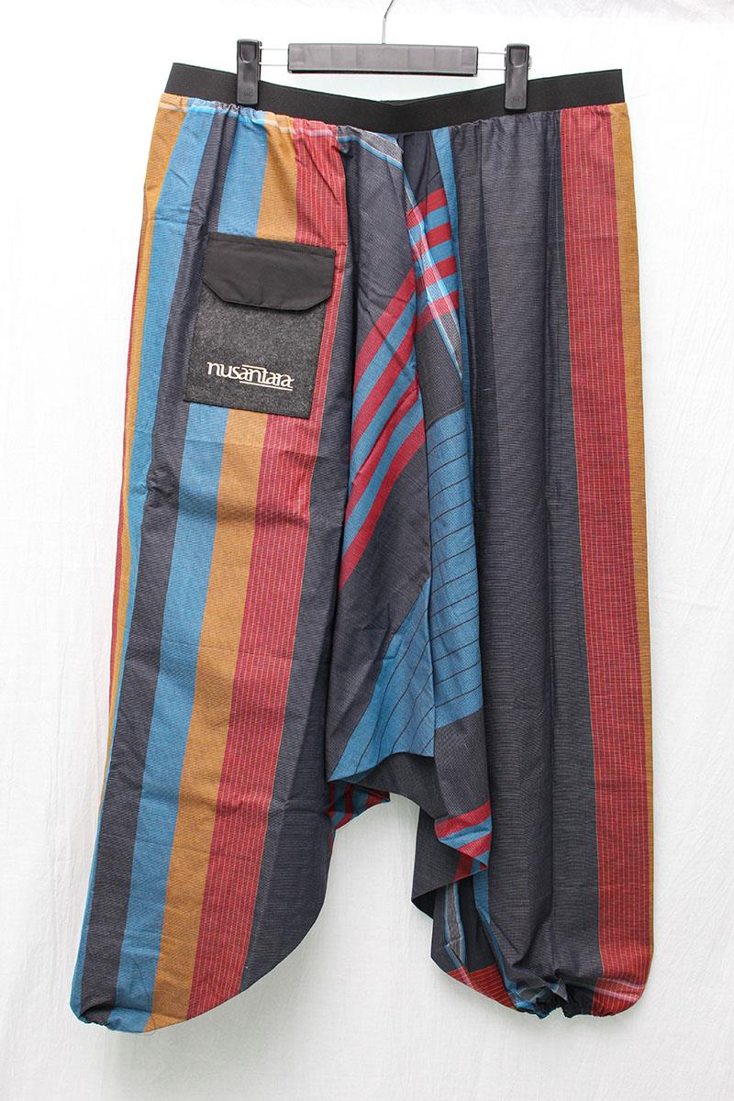
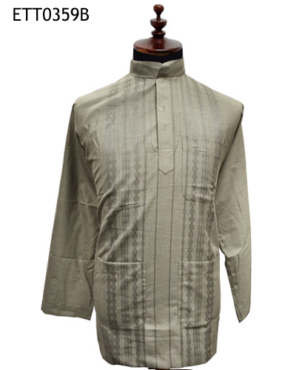
Supplier’s product page (products) - inventory
Lokallah SDN Bhd | log out
Product Name: Seluar pelekat
Edit
Home
Size Quantity Product ID
S 70 #K0098
M 50 #K0099
L 30 #K0100
Products
Remove
History
Product Name: baju raya
Edit
Agents
Size Quantity Product ID
S 0 #B0098
M 0 #B0099
L 30 #B0100
Sales Report
Remove
Active request
+

Slide 3
Supplier’s + product page
Lokallah SDN Bhd | log out
Home
+
Insert photo
Product name:
ID no:
Products
Size Quantity Note
XS
S
M
L
XL
History
Agents
Sales Report
Active request

Slide 4
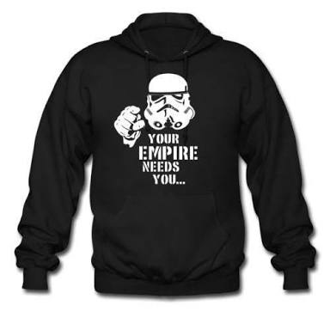
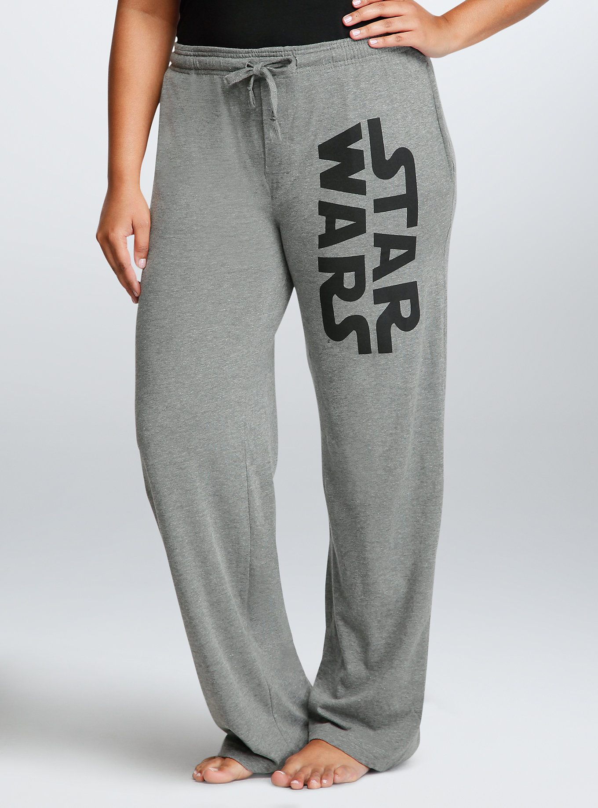
(past transaction) Supplier’s history page
Lokallah SDN Bhd | log out
Home
Product Name: baju stawos
Status Recipient Quantity Date (last modified)
Received Aiman (ID) 70 01/04/2016
Products
Size Quantity Product ID
S 70 #K0098
M 50 #K0099
L 30 #K0100
History
Agents
Sales Report
Product Name: seluar stawos
Status Recipient Quantity Date (last modified)
Cancelled Aiman (ID) 100 01/04/2016
Active request
Size Quantity Product ID
S 70 #K0098
M 50 #K0099
L 30 #K0100

Slide 5
Supplier’s agent page
Edit
Lokallah SDN Bhd | log out
56000
Home
Past Order
Name ID Type
Aiman #SK0067 Stockist/agent
Products
Current Order
Details
Phone: 014-218867
Email: aiman@mysa.com
Address: no 22, jalan utara anjing
Remove
History
Agents
Past Order
Name ID Type
Sarah #SK0067 Stockist/agent
Current Order
Sales Report
+
Active request
43200
Past Order
Name ID Type
hanana #SK0067 Stockist/agent
Current Order
+

Slide 6
Supplier’s + page to find agent
Lokallah SDN Bhd | log out
Search keyword:
ID number:
Home
Products
Name: Rosman ali
ID number: #KL0059
Poscode: 86000
+
History
Details
Phone: 014-218867
Email: rosy@mysa.com
Address: no 22, jalan utara anjing
Link: FB, Insta
Agents
Sales Report
Active request
+
Name: Miyo Bolo
ID number: #KL0567
Location: 45900
Details
Phone: 014-218867
Email: aiman@mysa.com
Address: no 22, jalan utara anjing
Link: FB, Insta

Slide 7
Supplier’s sales report
Lokallah SDN Bhd | log out
Home
Products
History
Agents
Sales Report
Active request

Slide 8

Agent dashboards - home
Al Zawierismmss | log out
Active orders
Home
Product Name: Baju A
Status Supplier Quantity Date (last modified)
Pending lokallah (ID) 70 01/05/2016
Order
History
Suppliers
Product Name: Baju raya
Status Supplier Quantity Date (last modified)
Reserved lol (ID) 100 03/05/2016
Sales Report
Active request
Notes
Watch apocalypse
Beli nasi lemak
Uncharteddd 4 bruhh
X
X
X

Slide 9
Agent’s suppliers page
Al Zawierismmss | log out
Home
Past Order
Name ID Product Type
lokallah #SK0067 fesyen
Order
Current Order
Details
Phone: 014-218867
Email: lolkalah@mysa.com
Address: no 22, jalan utara anjing
Remove
History
Suppliers
Past Order
Name ID Type
Sarah #SK0067 Stockist/agent
Current Order
Sales Report
+
Active request

Slide 10
Agent’s + page to find suppliers
Al Zawierismmss | log out
Search keyword:
ID number:
Home
Order
Name: Lokallah sdn bhd
ID number: #KL0098
Product type: fashion
Location: jalan besar TTDI mak kau,
45800 batu 2
+
History
Suppliers
Details
Phone: 014-218867
Email: aiman@mysa.com
Address: no 22, jalan utara anjing
Link: FB, Insta
Sales Report
Active request
+
Name: lelelel bhd
ID number: #KL0567
Product type: bantal
Location: jalan besar TTDI mak kau,
45800 batu 2
Details
Phone: 014-218867
Email: aiman@mysa.com
Address: no 22, jalan utara anjing
Link: FB, Insta

Slide 11

Agent’s order page
Al Zawierismmss | log out
Home
Lokallah Sdn Bhd
Product Name: Seluar pelekat
Order
Size Quantity Product ID Availibility
S #K0098
M #K0099
L #K0100
10
10
History
0
Suppliers
Product Name: baju raya
Sales Report
Size Quantity Product ID Availibility
S #B0098
M #B0099
L #B0100
70
15
30
Active request
Stawos Sdn Bhd

Slide 12
Agent’s history
Al Zawierismmss | log out
Home
Product Name: baju stawos
Status Supplier Quantity Date (last modified)
Received Stawos Bhd (ID) 70 01/04/2016
Order
Size Quantity Product ID
S 70 #K0098
M 50 #K0099
L 30 #K0100
History
Suppliers
Sales Report
Product Name: seluar stawos
Status Supplier Quantity Date (last modified)
Cancelled Stawos bhd 100 01/04/2016
Active request
Size Quantity Product ID
S 70 #K0098
M 50 #K0099
L 30 #K0100

Slide 13
Display when creating new account
Are you a…
New Supplier
Registered Supplier
New Agent
Registered Agent

Slide 14
New supplier
Details
Owner:
Company Name:
Type of product:
Email:
HQ address:
Phone Number:
Social media link: FB, insta, tumblr
New agent
Details
Name:
Gender:
Age range/ Age/ date of birth:
Phone number:
Email:
Shipping address:
Operating loation:
Social media link: FB, insta, tumblr
Suppliers verification:

Slide 15
Marketing strategy
Make a video app maam duoplane punye vid (informative and entertaining)
Make our apps viral
Have ambassador
Future features for our service
Tracking system from the product
Accounting sync (invoice, financial data, sales data, fully automatically sync)
Send alert on dashboard
Profitability reports
Metric

